Slide 1
Detecting Crowd Density
In
Passenger Cars (Train)
Khashbat Enkhbat

Slide 2
01
02
Problem / Current State
How IOT may solve it?
03
04
Suggest Solution
Discussion & Conclusion

Slide 3
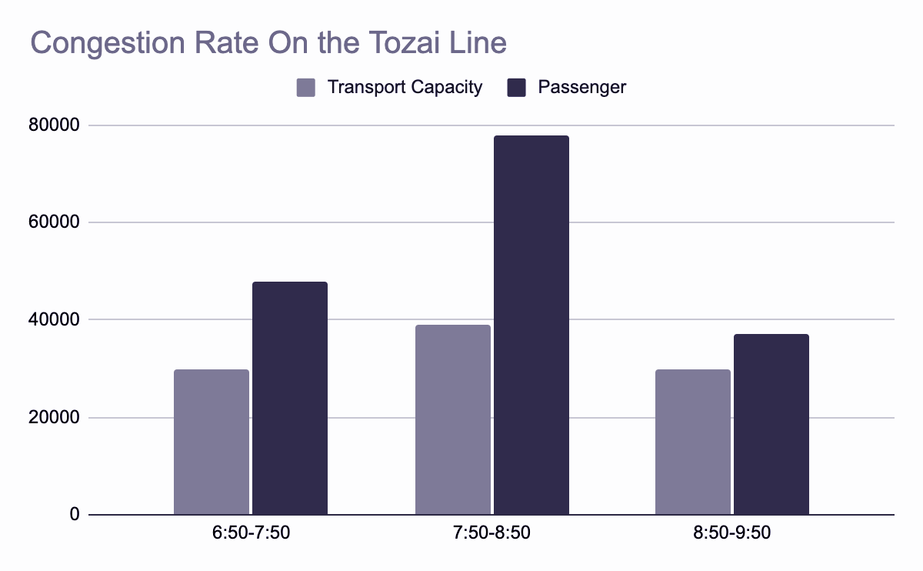
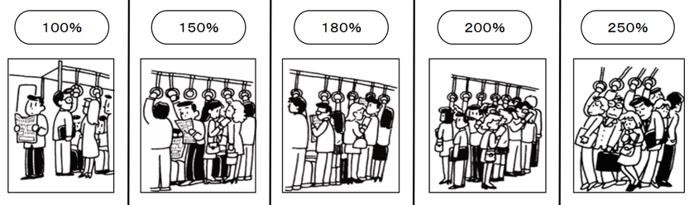
Current State:
Congestion Rate
200%
Source: Ministry of Land, Infrastructure, Transport, and Tourism, 2018

Slide 4
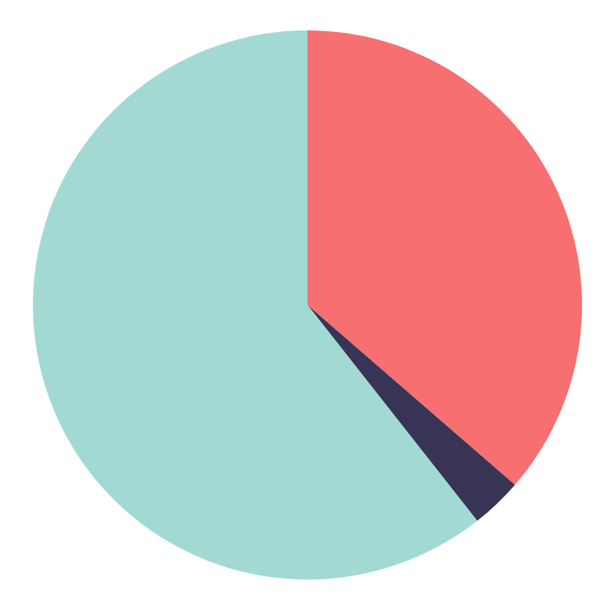
Problem
36%
3%
60.4%
Congestion is the biggest reason of small scale delay.
Others
Medical emergency, troubles at crossover, arguing between passengers
Malfunction of train and other facilities
Congestion
Source: Ministry of Land, Infrastructure, Transport and Tourism, 2019
This happens almost every day.

Slide 5
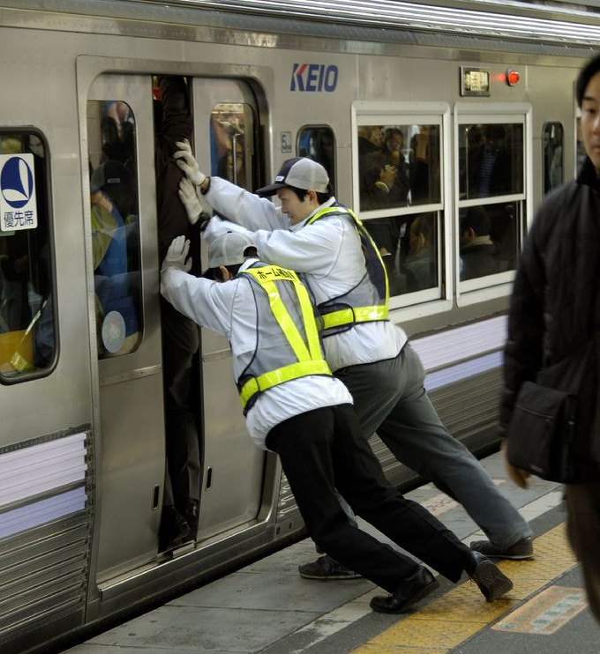
Problem
Too dangerous for babies, kids, pregnant ladies, and elderlies.
Oxygen rate decreases.
Too much interaction
Mental stress

Slide 6
There is always a bias in the distribution depending on train cars!!
Carriage with the air conditioning set to a higher temperature during summer season.
Car that is located far from stairs and ticket gates.
Women-only carriage
Those cars are tend to be not crowded comparing to the other ones because of the natural human behavior pattern.
However

Slide 7

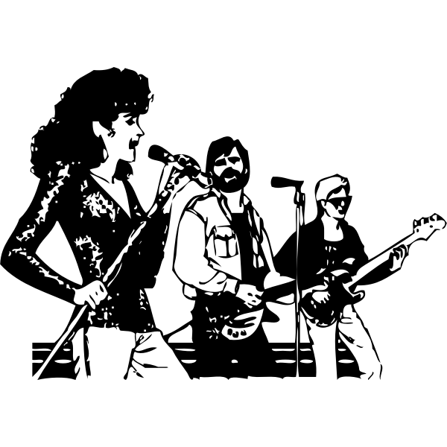
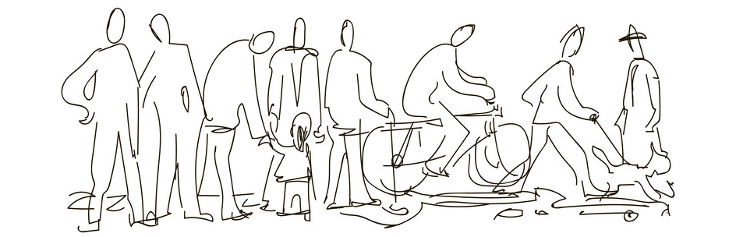
Those spacious cars will be different depending on
TIME
EVENTS
Weather
And it is too much work for passengers to predict whether train will be crowded or not based on those factors by themselves...

Slide 8
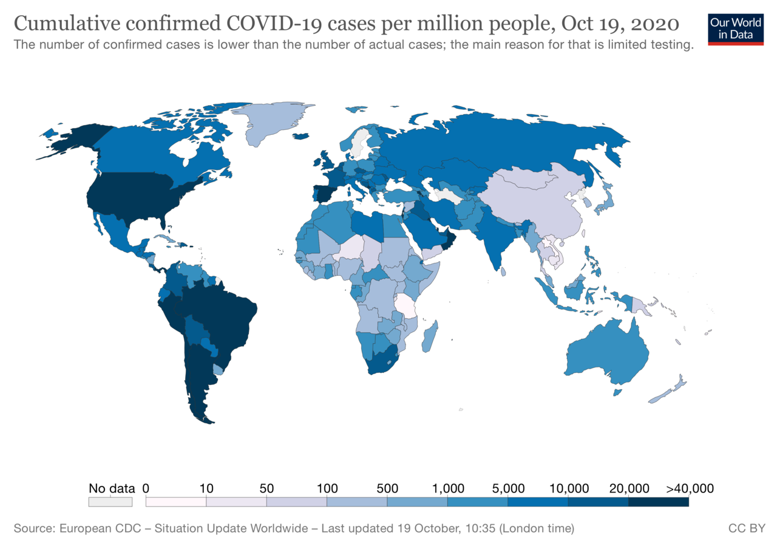
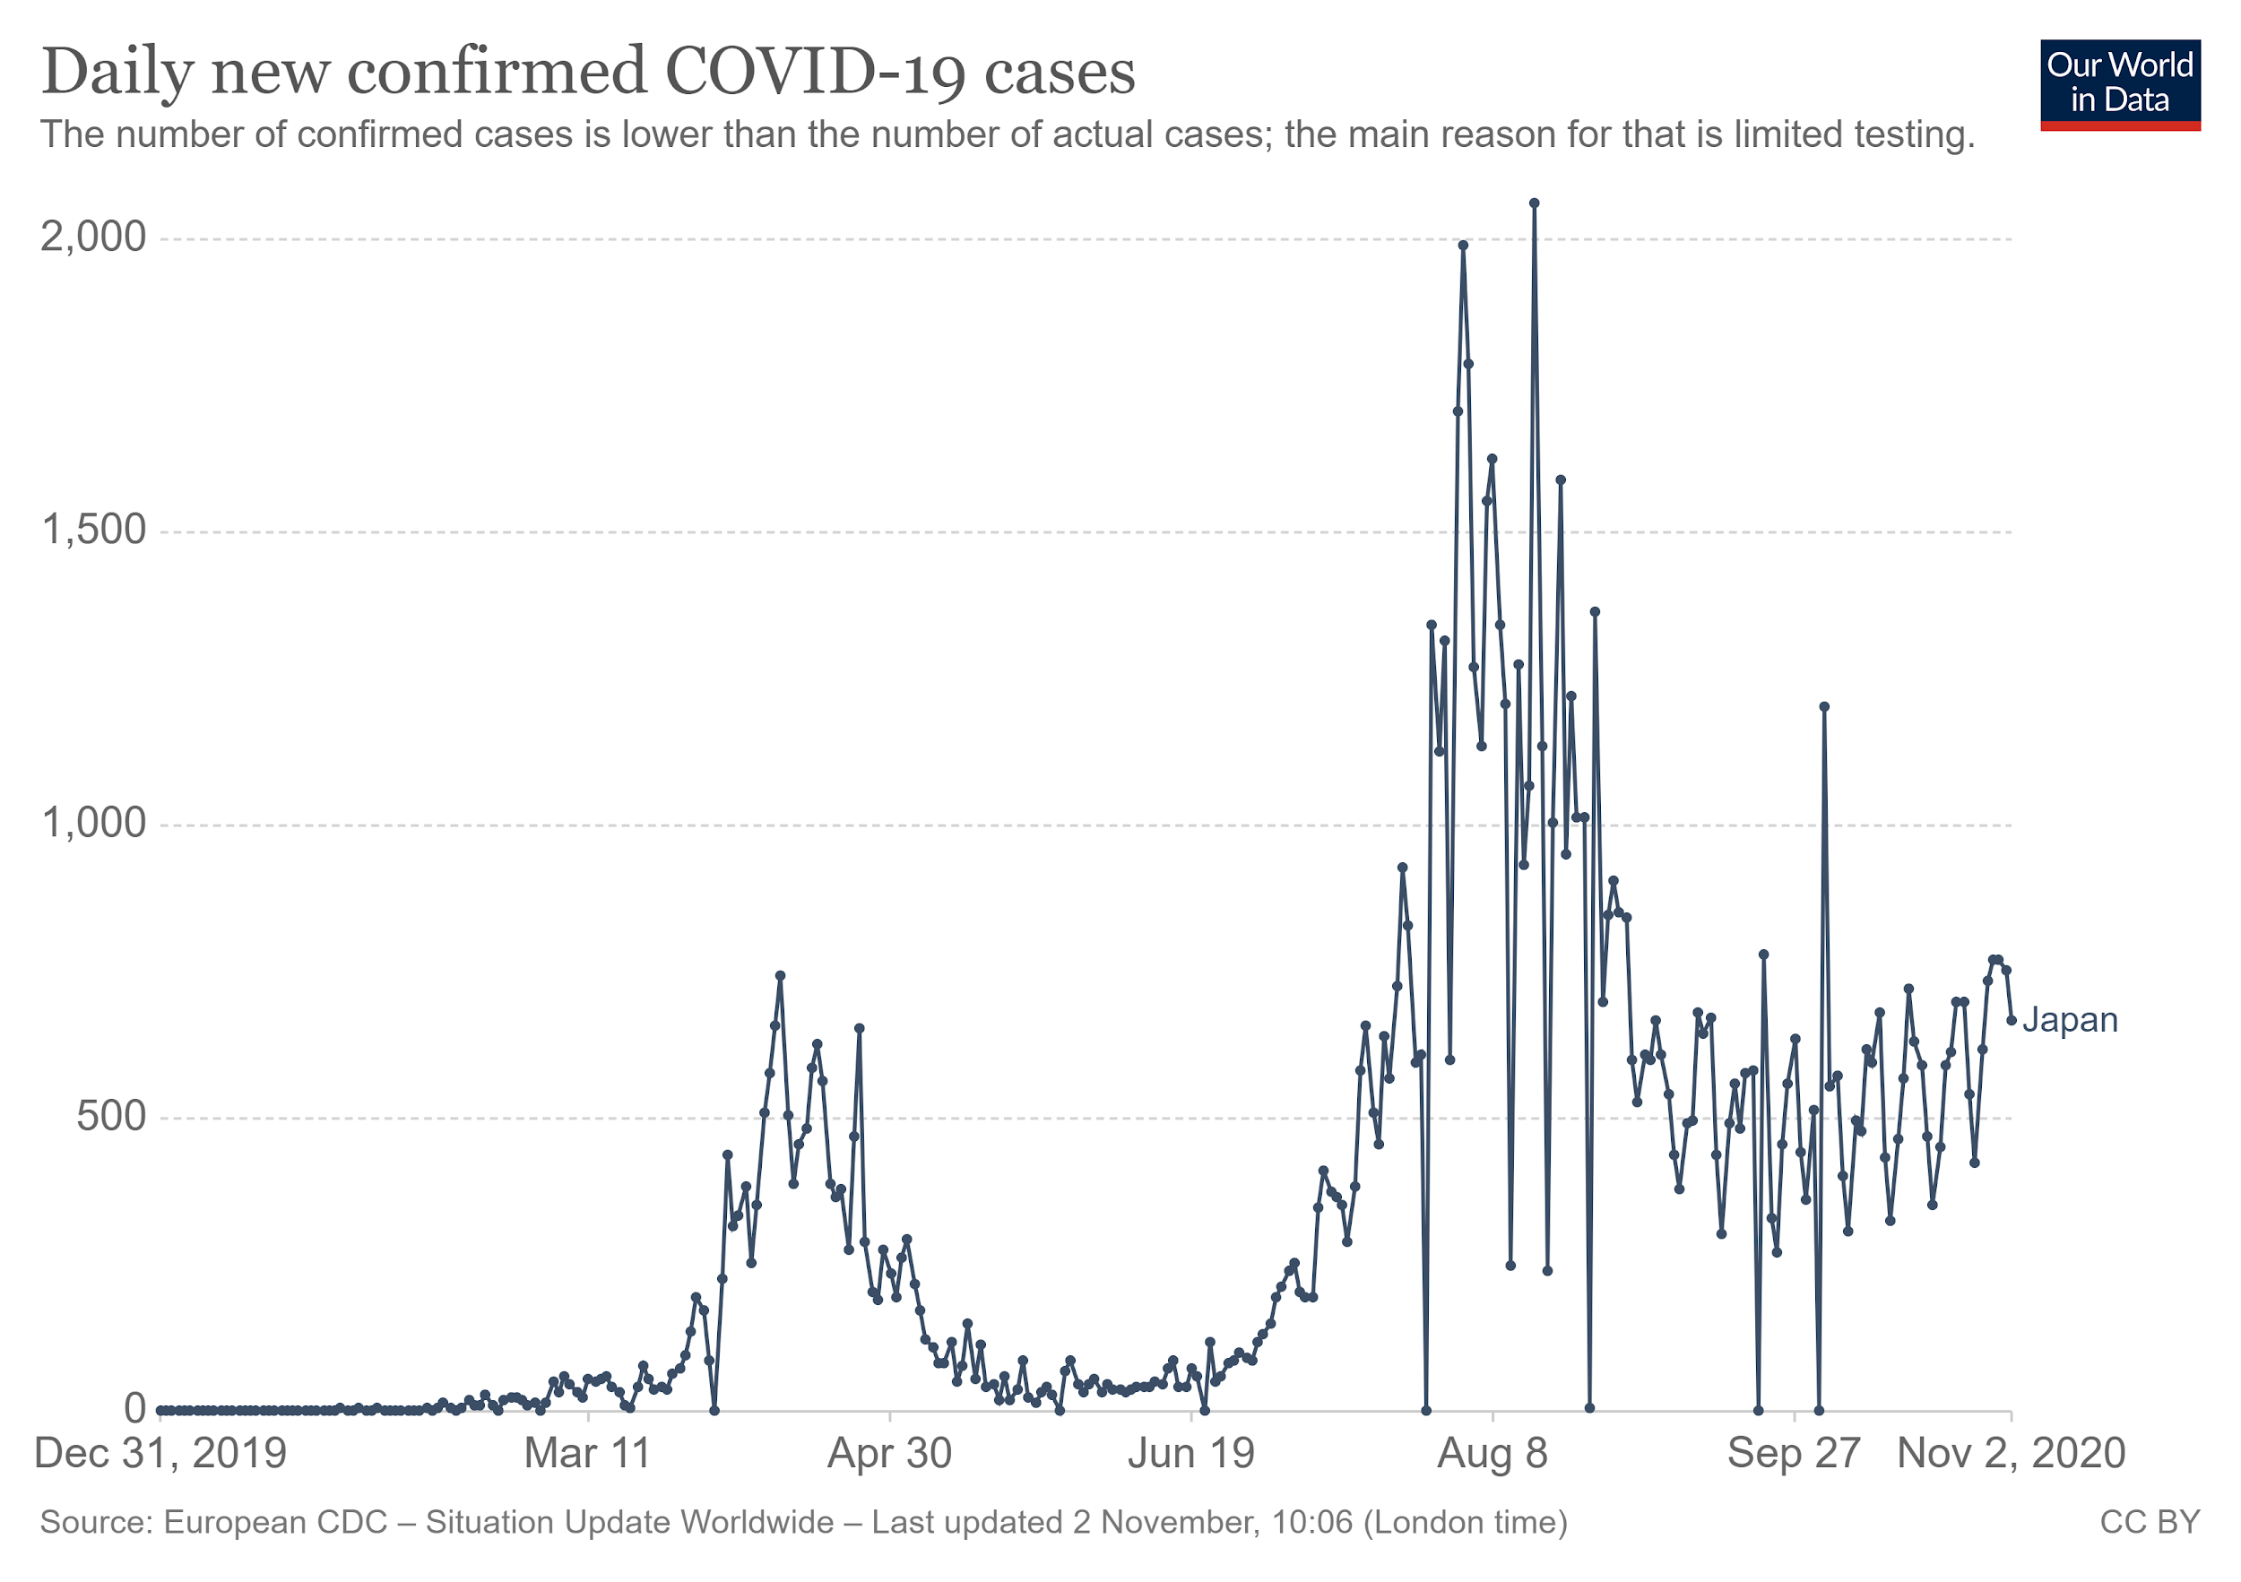
Current State
COVID-19 is still spreading
Source: Our World in Data,2020
https://ourworldindata.org/coronavirus/country/japan?country=~JPN

Slide 9
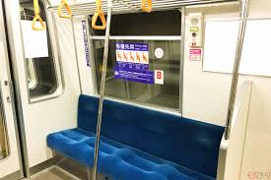
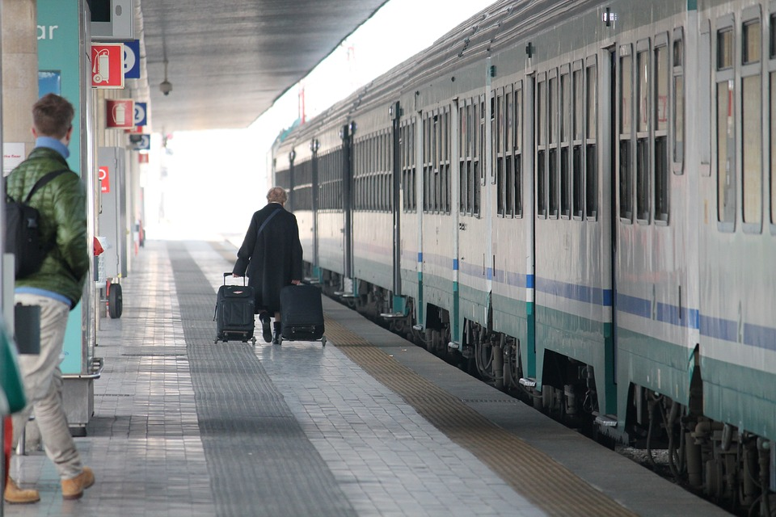
We began to adapt to the situation
Open the window to ventilate
Shift commuting time

Slide 10
Data-driven simulation build from accurate actual day reconstruction
Planners could to extend the morning and evening peak hours to support working hours
Commuter real time data
WIFI data from the computer phones can become a key sensor to track commuters on the transport network.
WIFI able to generate crowd density at the platform inside the trains by using an anonymous, non-participatory method.
Agencies can start using probabilistic models along with big data analytics to extract information at the platform crowd density and station vicinity crowd level
Computer information available to apply context-aware infusion analytics which will provide information about the causes of crowd surges and inadequate supply-demand levels.
SOLUTION
Using AI & IOT
Reference: https://www.traffictechnologytoday.com/features/white-paper-how-ai-and-iot-can-reshape-public-transit-in-the-covid-era.html
Notes:
WIFI data from the commuter phones can become a key sensor to track commuters on the transport network. WIFI data will be able to help generate crowd density at the platform or inside the trains by using an anonymous, non-participatory method. Agencies can start using probabilistic models along with big data analytics to extract information like platform crowd density and station vicinity crowd levels. Once the commuter information is available, we need to apply context-aware fusion analytics which will provide information about the causes of crowd surges and inadequate supply-demand levels.

Slide 11
These solutions can
Agencies and Operators will be able to monitor the crowd levels in real time as well as understand the context of the crowd levels.
SOPs trigger AI-based real time simulation which will provide optimised response plans like injecting additional train.
Improved response during all types of accidents, track failure, signalling system issues.
Agencies will be able to implement data-driven analytics to understand most valuable sites.
For companies generate increasing Advertising and commercial value for agencies.
Reference: https://www.traffictechnologytoday.com/features/white-paper-how-ai-and-iot-can-reshape-public-transit-in-the-covid-era.html
Notes:
Using the above models, agencies and operators will be able to monitor the crowd levels in real time as well as understand the context behind the crowd levels. Alert thresholds for crowd levels will be defined based on the new social distancing norms. Agencies will need to define Standard Operating Procedures (SOP) to handle these alerts. These SOPs would trigger Al-based real time simulation which will provide optimised response plans like injecting additional trains and buses. Agencies will have to implement agile simulation systems to automate these SOPs. In the past, simulation capabilities were utilised primarily on quarterly basis for headway optimisations. With advances in high-performance computing and big data, agencies will be able to utilise simulations in real time to solve crowding problems. It is not just for crowding incidents but this system can be utilised for improving response times during all types of incidents, track failures, signalling systems issues.
Agencies will be able to implement data-driven analytics to get better understanding of sites like the most valuable site for companies which would help generate increased advertising and commercial revenue for agencies.

Slide 12
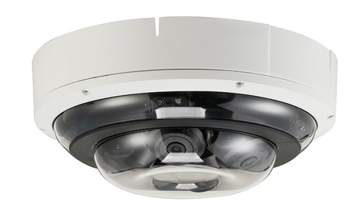
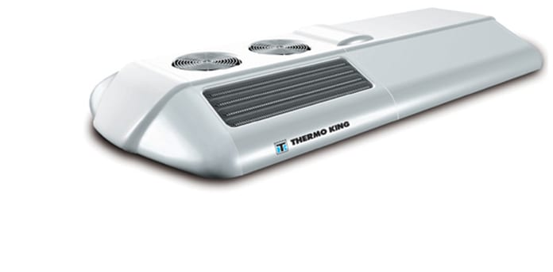
What kind of data must be detected?
What kind of devices do you need?
Images, Videos → People/Head detection
Sensors: Smart video sensors.
How to set up: Multiple (3) cameras inside each train car (on the ceiling)
Usages: For security purposes and head counting
Actuators:
Air-conditioning system (dynamic and depend on density → Saving electricity)
Sending information to the application
2 号車 Level 1
1 号車 Level 2
6 号車 Level 3
8 号車 Level 4
4 号車 Level 5

Slide 13
Diagram (How the system works)
Detection-based
Smart video sensors
Input data
(Images, Videos)
Approaches
Regression-based
CNN-based
density estimation
Features
Air-conditioning system
Conclusion
(Crowd Detection)
Notification
via the app
*Reference: Chaudhari, M. D., & Ghotkar, A. S. (2018). A Study on Crowd Detection and Density Analysis for Safety Control.
Notes:
Chaudhari, M. D., & Ghotkar, A. S. (2018). A Study on Crowd Detection and Density Analysis for Safety Control.

Slide 14
Approaches
Detection-based: usually apply a person or head detector via a sliding window on an image, which can be done by R-CNN and YOLO that may perform dramatic detection accuracy in the sparse scenes.
(-) Presenting unsatisfactory results when encountered the situation of occlusion and background clutter in extremely dense crowds.
Regression-based: methods which directly learn the mapping from an image patch to the count. They usually first extract global features (texture, gradient, edge features), or local features (SIFT, LBP, HOG, GLCM).(Regression techniques such as linear regression and Gaussian mixture regression are used to learn a mapping function to the crowd counting.)
(+) Dealing with the problems of occlusion and background clutter
(-) Always ignoring spatial information.
*Reference: Gao, G., Gao, J., Liu, Q., Wang, Q., & Wang, Y. (2020). CNN-based Density Estimation and Crowd Counting: A Survey. arXiv preprint arXiv:2003.12783.
Notes:
https://arxiv.org/pdf/2003.12783.pdf
Local Binary Pattern (LBP) is a simple yet very efficient texture operator which labels the pixels of an image by thresholding the neighborhood of each pixel and considers the result as a binary number.
SIFT (scale invariant feature transform): solve visual tracking problem, where the appearances of the tracked object and scene background change during tracking.
Histogram of oriented gradients (HOG) is a feature descriptor used in computer vision and image processing for the purpose of object detection. The technique counts occurrences of gradient orientation in localized portions of an image.
Global features have the ability to generalize an entire object with a single vector. Consequently, their use in standard classification techniques is straightforward. Local features, on the other hand, are computed at multiple points in the image and are consequently more robust to occlusion and clutter. However, they may require specialized classification algorithms to handle cases in which there are a variable number of feature vectors per image.

Slide 15
Approaches
Density estimation: learning a linear mapping between local features and corresponding density maps.
(+) This technique considers the spatial information.
(-) Using traditional hand-crafted features to extract low level information, which cannot guide the high-quality density map to estimate more accurate counting.
CNN-based density estimation: Recently, thanks to the power of CNNs, more researchers apply them to improve the density estimation. Earlier heuristic models typically leverage basic CNNs to predict the density of the crowds, which obtain significant improvement compared with traditional hand-crafted features.
*Reference: Gao, G., Gao, J., Liu, Q., Wang, Q., & Wang, Y. (2020). CNN-based Density Estimation and Crowd Counting: A Survey. arXiv preprint arXiv:2003.12783.
Notes:
https://arxiv.org/pdf/2003.12783.pdf
Local Binary Pattern (LBP) is a simple yet very efficient texture operator which labels the pixels of an image by thresholding the neighborhood of each pixel and considers the result as a binary number.
SIFT (scale invariant feature transform): solve visual tracking problem, where the appearances of the tracked object and scene background change during tracking.
Histogram of oriented gradients (HOG) is a feature descriptor used in computer vision and image processing for the purpose of object detection. The technique counts occurrences of gradient orientation in localized portions of an image.
Global features have the ability to generalize an entire object with a single vector. Consequently, their use in standard classification techniques is straightforward. Local features, on the other hand, are computed at multiple points in the image and are consequently more robust to occlusion and clutter. However, they may require specialized classification algorithms to handle cases in which there are a variable number of feature vectors per image.

Slide 16
First step of programming the people detector.
Is to use the camera of the train to take pictures every 5 minutes for the use of data analysis.
The pictures can be deleted right after the use of data analysis, or it could be saved later for security purposes.
Let’s take a look at how we can connect the camera to the system.

Slide 17
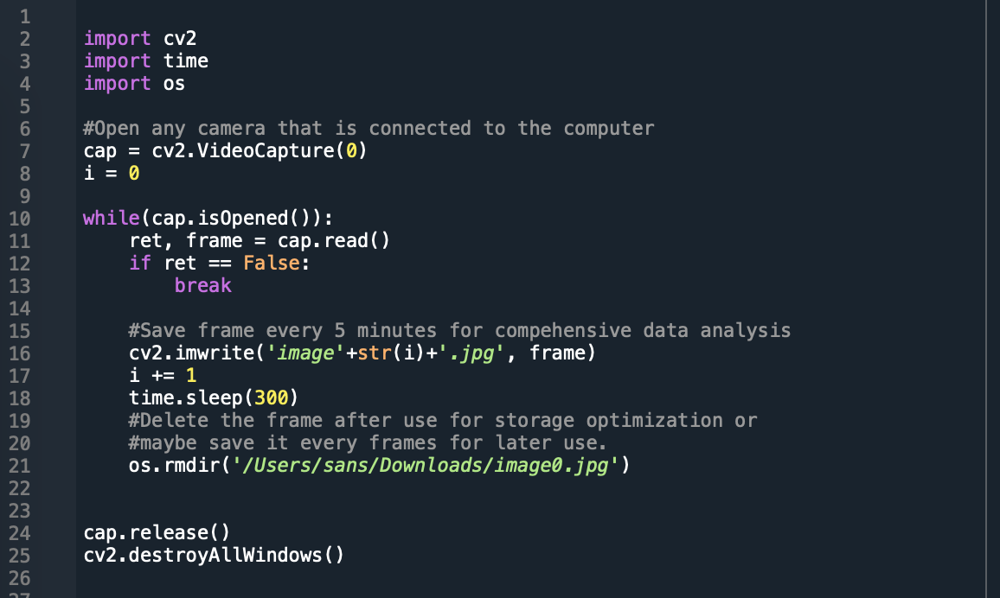
Programming section

Slide 18
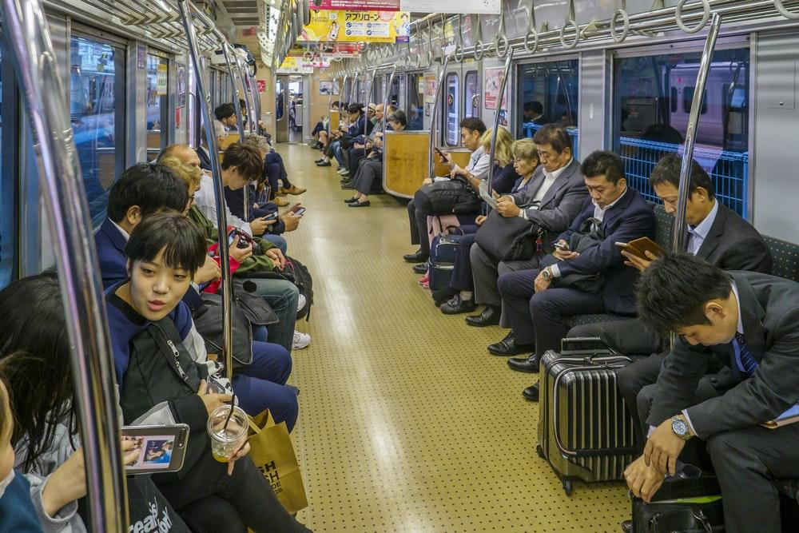
Second step of programming the people detector.
Example picture
Is to use machine learning algorithms to count the objects inside a train.
CVlib is useful for these computer vision applications.
Let’s take a look at how we can count objects from the pictures that we take every 5 minutes.

Slide 19
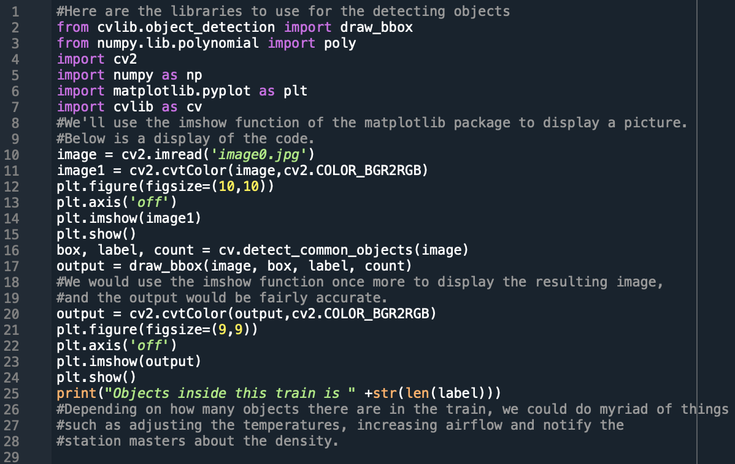
Programming section #2

Slide 20
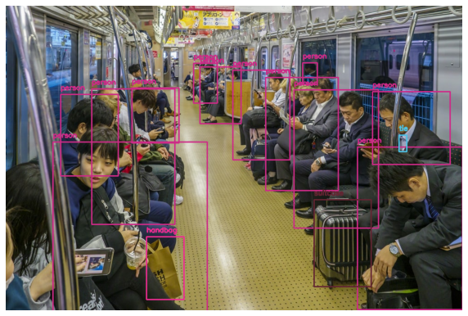
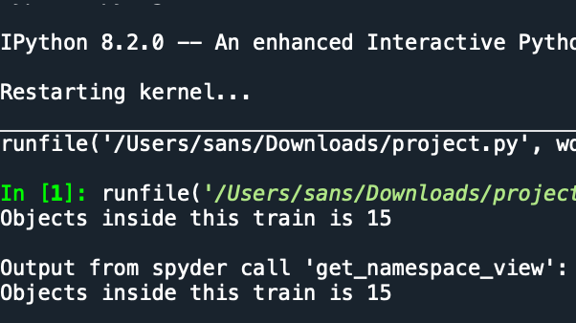
The final result
Processed Example picture
The output given the example picture.
Depending on how many objects there are in the train, we could do myriad of things such as adjusting the temperatures, increasing airflow and notify the apps or station masters about the density.

Slide 21
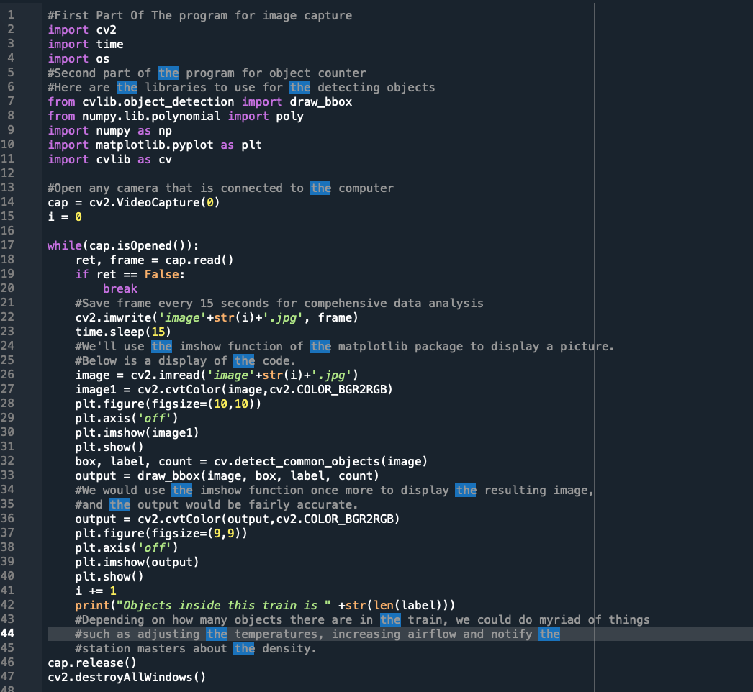
The combined approach for simultaneous processing
With combined approach from previous two methods, we can make a program that simultaneously takes photos and tells how many objects there are in the taken picture. It is a good thing that we can use available machine learning techniques just by calling a library. Try my program, but you would need to install cv2 module as well as cvlib module, which could take 30 minutes to 1 hour depending on your CPU.

Slide 22
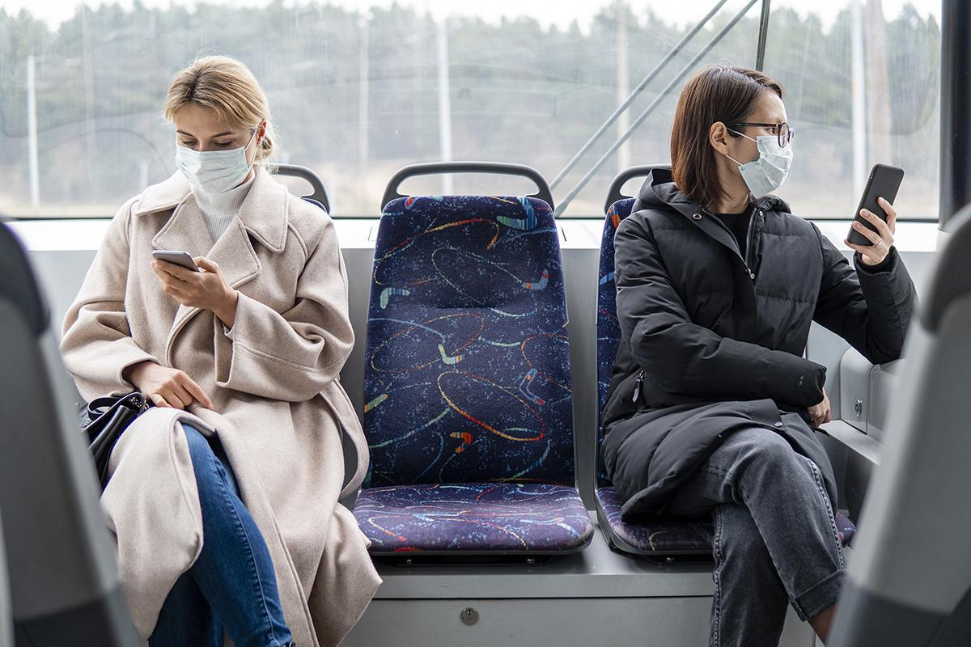
How may our suggestion solve the problem?
Help to decrease the risk of covid affection.
Distribute the number of people more properly amongst the train cars, and ventilate the train cars with ease.
Help increase the passengers’ satisfaction.
Many people are anxious about getting affected by Covid. Our solution may put the mind of people at ease especially the elders.
Help the train companies to schedule train repetition.
The information we obtain from our system is highly valuable to train companies, as it helps them to schedule trains routes/timing more precisely based on the information of crowdedness in the train at a specific time.

Slide 23
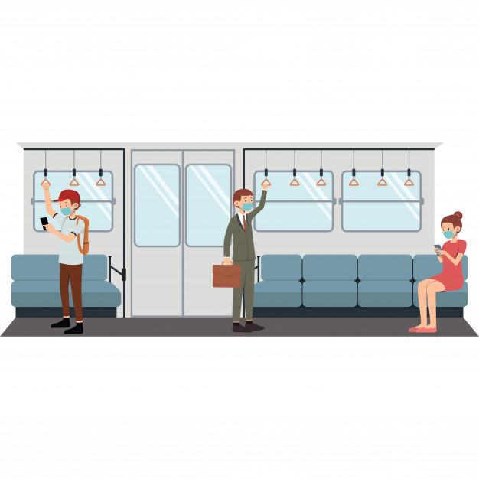
How may our suggestion solve the problem?
Help the passengers to plan their trip.
Passengers have access to the information of crowdedness of transport vehicles they are intending to use which will help them plan their trip accordingly.
Especially in these COVID situations, people want to take any kind of transport vehicle with less crowd density. The information obtained allows them to check and decide their preferred time for trip.
Many more applications
Helps in future fever seasons or pandemic situations. After installed, it can be used to prevent the spread of flu or other viruses.
Could be used to select which seats to heat as a way to decreasing energy consumptions and more.

Slide 24

Discussions and Conclusions
The set-up is simple but brings effectiveness
Serving multi-purposes (security and crowd allocation)
Besides crowd estimation, prediction can be brought into consideration.

